Slide 1
DSI Project 3
Web APIs & Classification
Ng Jun Kang

Slide 2
Who am I?
Data Science start-up company pitching to Square Enix
Advocating on the use of data gathering from social media and data science products to understand the gaming community
Outcome and insights to be used for product analysis and future product development

Slide 3
Problem Statement
As the gaming population is getting younger, there is a need to explore the concept of gathering sentiments from the gamming community through social media for product analysis and development
For proof of concept, prototype production classification models are built to classify posts from 2 different Sub-Reddits (FFVII Remake and FFXV)
Gain insights on the gaming product through the data science modeling process

Slide 4
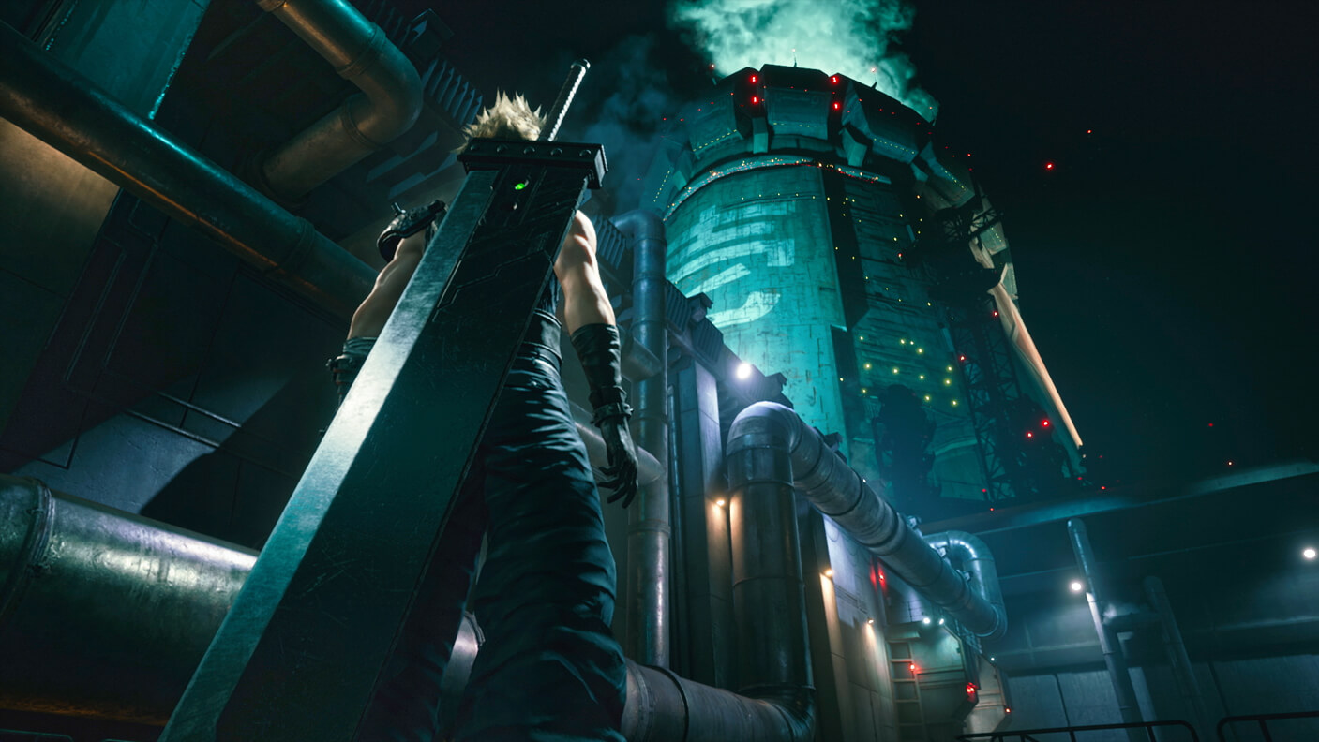
FFVII Remake
Genre: Action RPG
Developer: Square Enix
Platform: PS4
Initial Launch Date: 3 March 2020
New Launch Date 10 Apr 2020 (Part 1)
Site: https://ffvii-remake.square-enix-games.com/en-us

Slide 5
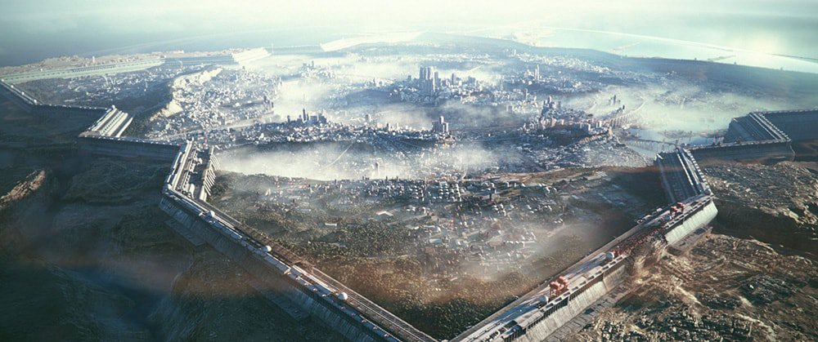
FFXV
Genre: Action RPG
Developer: Square Enix
Platform: PS4, Xbox One, Windows
Launch Date: 29 Nov 2016
Site: https://finalfantasyxv.square-enix-games.com/

Slide 6
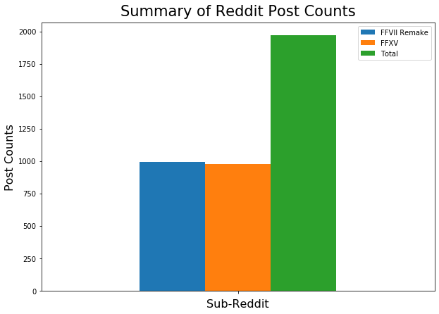
Reddit WebAPI
1969
992
977

Slide 7
Methodology
Reddit API Data Gathering
Data Analysis and Cleaning
Data Optimization
Model Fitting and Evaluation
Naive Bayes
Logistic Regression
Voting Classifier (Naive Bayes and Logistic Regression)

Slide 8
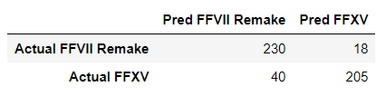
Naive Bayes
Text Cleaning, Stemming
Count Vectorizer Pipeline Optimization
Baseline Score: 0.503
Training Score: 0.952
Test Score: 0.882

Slide 9

Logistic Regression
Text Cleaning, Stemming
Baseline Score: 0.503
Training Score: 0.991
Test Score: 0.878
Comparable performance
Better FFVII Remake Predictions

Slide 10
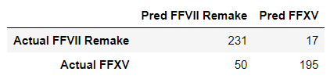
Voting Classifier
Naive Bayes and Logistic Regression
Count Vectorizer Pipeline Optimization
Text Cleaning, Stemming
Baseline Score: 0.503
Training Score: 0.954
Test Score: 0.874
Comparable performance

Slide 11
Top Naive Bayes Features
FFVII Remake
Features. (‘ocean’, ‘canyon’, ‘emerald’) & (‘pari’, ‘taipei’)
Suggest the community is ready and keen to interact with end-game content (Part 2 onwards)
Community localization interest with Paris and Taipei
FFXV
Features. ‘ryzen’, ‘rtx’, ‘gtx’
Suggest the community is concern about PC hardware related topics

Slide 12
Inference and Conclusion
High FFVII Remake Sub-Reddit post counts at product pre-launch suggest that the FF community is comfortable with social media as compared to in 2016
Data science prototype production models achieved good classification performance results, able to get a high-level sensing on the sentiments of the community
Data mining and modeling of social media data able to assist in FF product analysis and future development

